Slide 1
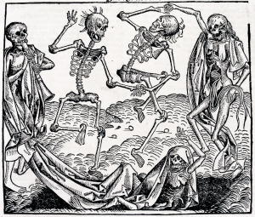
The Black Death
To be able to investigate the causes and cures of the Black Death
Key Words
Symptoms
Buboes
Causes
Cures
Prevent

Slide 2
Check your progress!
Can you identify the symptoms of the black Death?
Can you investigate the causes and how to cure and prevent of the Black Death?
Can you identify why the Black Death spread so easily?

Slide 3
Starter
Can you identify the symptoms of the black Death?
What are symptoms?
So what are the symptoms of the Black Death, a horrible plague that was in Europe in 1348-1350?

Slide 4
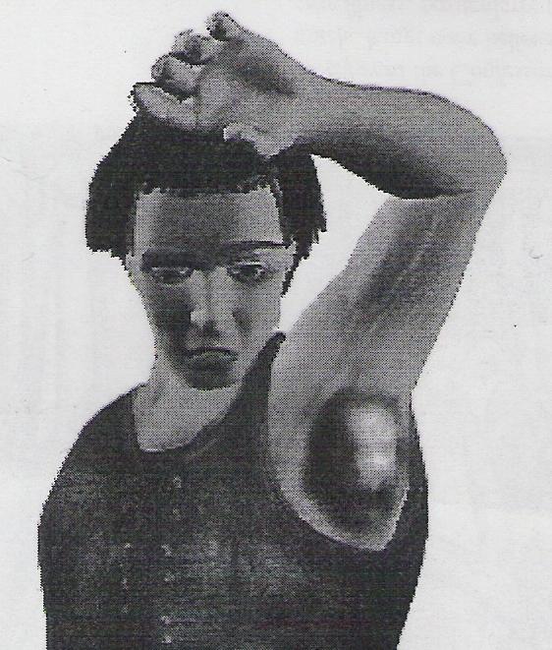
Day 1
Can you identify the symptoms of the black Death?
Boils called Buboes grow under your arms

Slide 5
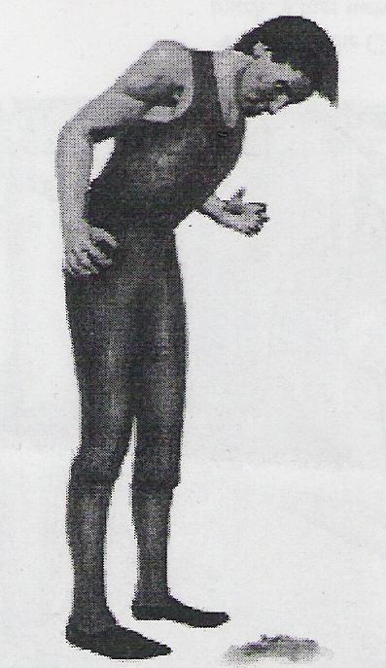
Day 2
Can you identify the symptoms of the black Death?
You get a terrible fever, you will vomit and spit blood

Slide 6
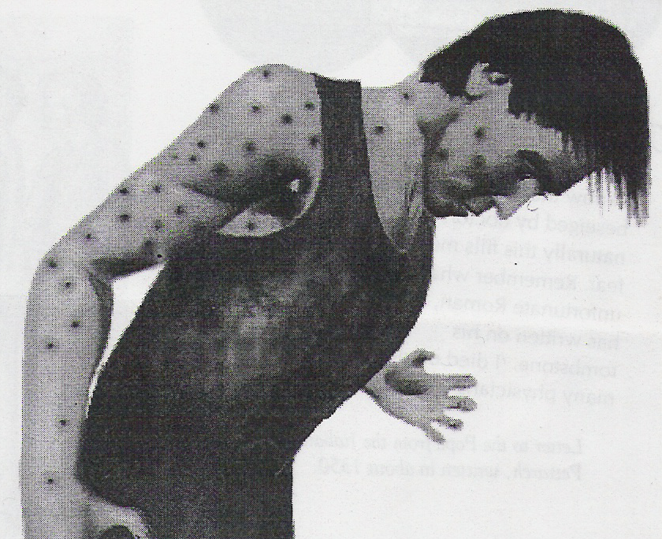
Day 3
Can you identify the symptoms of the black Death?
Black spots appear, caused by bleeding under the skin

Slide 7
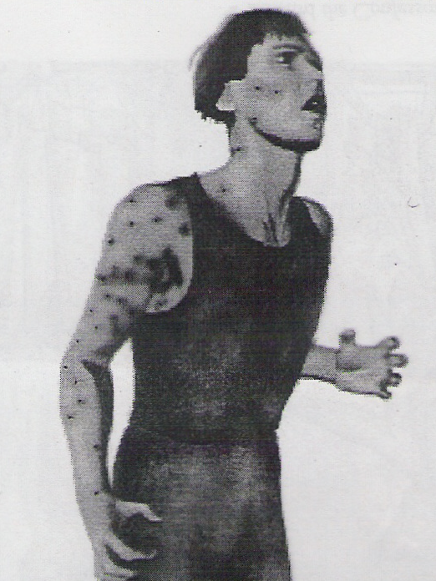
Day 4
Can you identify the symptoms of the black Death?
Terrible pains as the disease attacks the central nervous system

Slide 8
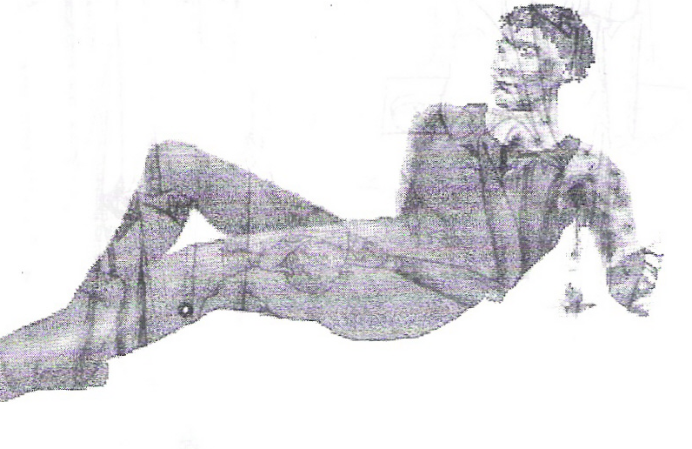
Day 5
Can you identify the symptoms of the black Death?
Your buboes burst, oozing a stinking liquid of black and yellow puss

Slide 9
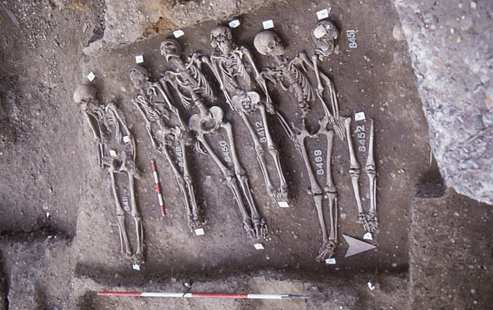
Day 6
Can you identify the symptoms of the black Death?
You might live, or….
DEATH

Slide 10
Activity
All…will be able to identify the symptoms of the black Death
What is wrong with these sentences?
The Black Def was first recorded in Britain in 1348
The black death casued green spots
Boills called buboes would appear on the hair?

Slide 11
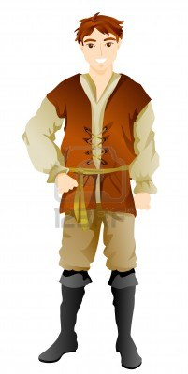
Activity
All…will be able to identify the symptoms of the black Death
Would this person survive the Black Death?
Keeps being sick, the lumps under his arms which he has had for about 4 days have started to burst and black liquid is coming out of them.
Also his friends are complaining that he smells really bad!

Slide 12
Activity
Can you investigate the causes and how to cure and prevent of the Black Death?
So who now can improve on their answer on symptoms?
Who can now tell me what are the symptoms of the Black Death?

Slide 13
Activity
Can you investigate the causes and how to cure and prevent of the Black Death?
Card Sorting Exercise
Identify the two headings
Causes
Cure and prevention
Use these headings to select the right cards for the symptoms and causes of the Black Death
Extension
Which card do you think would be the best to cure and prevent the Black Death? Why?
Can you compare it to another cure?

Slide 14
Causes
Can you investigate the causes and how to cure and prevent of the Black Death?
God’s punishment for sins such as gambling, swearing, money-lending and fighting.
Fleas passing the disease from rats to humans.
Dirty towns with heaps of rubbish everywhere.
It started in the East when frogs, snakes, lizards and scorpions fell from the sky- followed by thunder and lightening and fire.

Slide 15
Cure and prevention
Can you investigate the causes and how to cure and prevent of the Black Death?
Ringing church bells to pass on bad air.
Slicing open your boils and burning it with a red hot poker.
Cleaning the streets
Shaving a live chicken’s bottom and attaching it to your boils.

Slide 16
Activity
Can you investigate the causes and how to cure and prevent of the Black Death?
For the Causes and Cures
Try and place the causes into likely and unlikely causes
For the Cures
Try and place the causes into likely and unlikely Cures (hint- think back to Tuesdays lesson)

Slide 17
Conclusion Time
Can you investigate the causes and how to cure and prevent of the Black Death?
Now what does this tell us about the people in 1348-1350? (the time of the Black Death)
Why did the Black Death Spread so easily across Britain?
Think about what Medieval people thought about the causes of the Black Death- even your homework?
Think about what medieval people did to cure the Black Death- was it always successful?

Slide 18
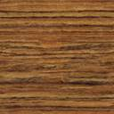
Extension 1
Can you identify why the Black Death spread so easily?
Can you use evidence to support a view?
Study this source and see if you can identify the cause of the Black Death
A letter to the Bishop of London in 1348 said...
Terrible is God towards the sons of men...He often allows plagues, famine, wars and other suffering and uses them to terrify men and so drive out their sins”

Slide 19
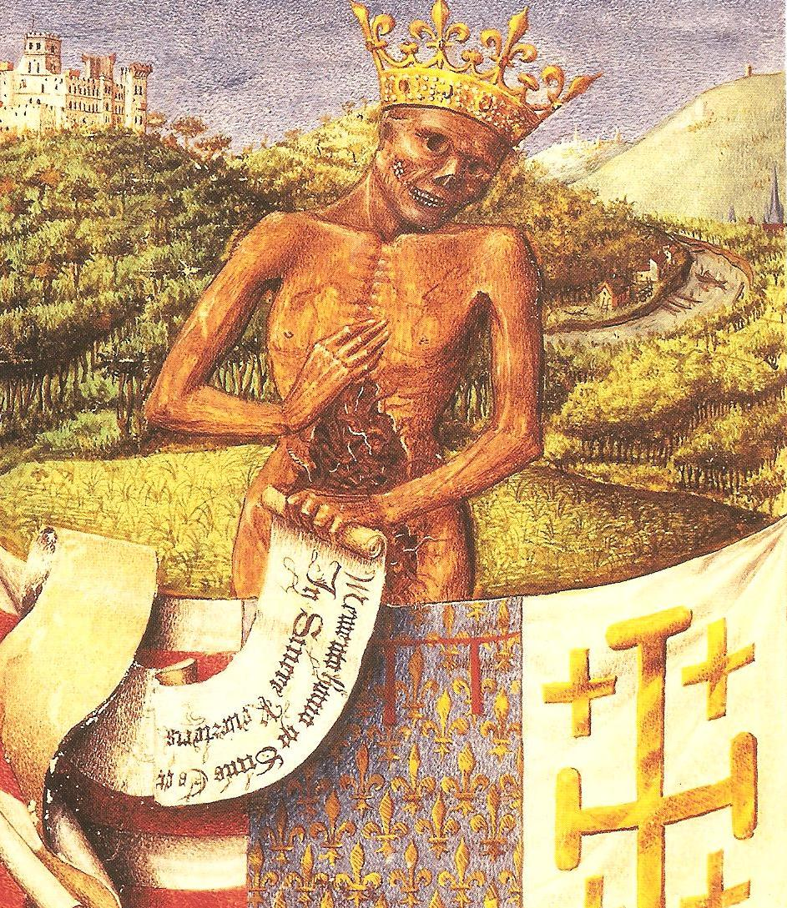
Extension 2
Some…will be able identify why the Black Death spread so easily?
King Death?
This is a painting from a French prayer book.
Why do you think it was called King Death?
What does this source say about attempts to stop the Black Death?

Slide 20
Plenary
Most…will be analyse the causes and cure and prevention of the Black Death
Create a mime to identify a key part of today’s lesson
Symptoms
Causes
Cures
See if others in the class can identify the key part you have identified

Slide 21
Plenary
Most…will be analyse the causes and cure and prevention of the Black Death
Can you spot the mistake?
The blackdeath was first reported in Britain in 1348
The Black Death was caussed by lizards falling fro the sky?
Boils called Buboes was a cause of eth Blackk Death

Slide 22
What have we learnt today
starter
All…will be able to identify the symptoms of the black Death
Most…will be analyse the causes and cure and prevention of the Black Death
Some…will be able identify why the Black Death spread so easily?
Card sorting, conclusion
extension

Slide 23
